Slide 1
LESSON 20

Slide 2
Overview
of
Previous Lesson(s)

Slide 3
Over View
Left Recursion elimination method:
A → Aα₁ | Aα₂ | … | Aα_{m} | β₁ | β₂ | … | β_{n}
Then the equivalent non-recursive grammar is
A → β₁A’ | β₂A’ | … | β_{n}A’
A’ → α₁A’ | α₂A’ | … | α_{m}A’ | ɛ
The non-terminal A generates the same strings as before but is no longer left recursive.

Slide 4

Over View..
Left factoring is a grammar transformation that is useful for producing a grammar suitable for predictive or top-down, parsing.
If two productions with the same LHS have their RHS beginning with the same symbol (terminal or non-terminal), then the FIRST sets will not be disjoint so predictive parsing will be impossible
Top down parsing will be more difficult as a longer lookahead will be needed to decide which production to use.
Ex.

Slide 5
Over View...
if A → αβ₁ | αβ₂ are two A-productions
Input begins with a nonempty string derived from α
We do not know whether to expand A to αβ₁ or αβ₂
However , we may defer the decision by expanding A to αA'
After seeing the input derived from α we expand
A' to β₁ or A' to β₂.
After removing left-factoring.
A → α A’
A' → β₁| β₂

Slide 6
Over View...
Recursive Descent Parsing
It is a top-down process in which the parser attempts to verify that the syntax of the input stream is correct as it is read from left to right.
A basic operation necessary for this involves reading characters from the input stream and matching then with terminals from the grammar that describes the syntax of the input.
Recursive descent parsers will look ahead one character and advance the input stream reading pointer when proper matches occur.

Slide 7
Over View...
FIRST(A → α) is the set of all terminal symbols x such that some string of the form xβ can be derived from α
FIRST:
For any string α of grammar symbols, we define FIRST(α) to be the set of terminals that occur as the first symbol in a string derived from α.
So, if α⇒*xβ for x a terminal and β a string, then x is in FIRST(α).
In addition if α⇒*ε then ε is in FIRST(α).

Slide 8
Over View...
The follow set for the non-terminal A is the set of all terminals x for which some string αAxβ can be derived from the starting symbol S
FOLLOW:
For any non-terminal A FOLLOW(A) is the set of terminals x that can appear immediately to the right of A in a sentential form.
Formally, it is the set of terminals x such that S⇒*αAxβ.
In addition, if A can be the rightmost symbol in a sentential form, the end marker $ is in FOLLOW(A)

Slide 9
Over View...
Ex: E → T E’
E’ → + T E’ | ɛ
T → F T’
T’ → *FT’ | ɛ
F → (E) | id
FIRST(F) = FIRST(T) = FIRST(E) = { ( , id }
Two productions for F have bodies that start with these two terminal symbols, id and the left parenthesis
T has only one production, and its body starts with F. Since F does not derive ɛ, FIRST(T) must be the same as FIRST(F)
The same argument covers FIRST(E)

Slide 10
Over View...
FIRST(E’) = {+, ɛ }
The reason is that one of the two productions for E‘ has a body that begins with terminal + and the other's body is ɛ
Whenever a non-terminal derives ɛ we place ɛ in FIRST for that non-terminal.
FIRST(T’) = {*, ɛ }
The reasoning is analogous to that for FIRST(E’)
FOLLOW(E) = FOLLOW(E') = {), $}
Since E is the start symbol, FOLLOW(E) must contain $.
The production body (E) explains why the right parenthesis is in FOLLOW(E) For E‘ this non-terminal appears only at the ends of bodies of ɛ-productions
Thus, FOLLOW(E’) must be the same as FOLLOW(E)

Slide 11
Over View...
FOLLOW(T) = FOLLOW(T') = {+, ) , $}
T appears in bodies only followed by E’ Thus, everything except ɛ that is in FIRST(E') must be in FOLLOW(T) that explains the symbol +.
However, since FIRST(E') contains ɛ (i.e. , E' =* t), and E' is the entire string following T in the bodies of the ɛ-productions, everything in FOLLOW(E) must also be in FOLLOW(T)
That explains the symbols $ and the right parenthesis.
As for T' since it appears only at the ends of the T-productions it must be that FOLLOW(T') = FOLLOW(T)
FOLLOW(F) = {+, *, ), $}

Slide 12
Over View...
LL(1) Grammars
Predictive parsers that is recursive-descent parsers needing no backtracking, can be constructed for a class of grammars called LL(1).
The first "L" in LL(1) stands for scanning the input from left to right.
The second "L" for producing a leftmost derivation.
“1" for using one input symbol of look ahead at each step to make parsing action decisions.

Slide 13
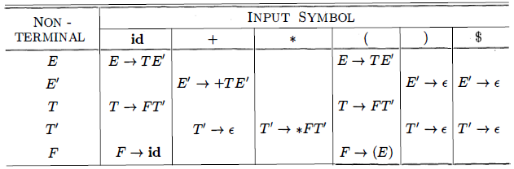
Over View...
Ex. E → T E’ FIRST(F) = FIRST(T) = FIRST(E) = { ( , id }
E’ → + T E’ | ɛ FIRST(E’) = {+, ɛ}
T → F T’ FIRST(T’) = {*, ɛ}
T’ → *FT’ | ɛ FOLLOW(E) = FOLLOW(E') = {), $}
F → (E) | id FOLLOW(T) = FOLLOW(T') = {+, ) , $}
FOLLOW(F) = {+, *, ), $}

Slide 14
TODAY’S LESSON

Slide 15
Contents
Top Down Parsing
Recursive Decent Parsing
FIRST & FOLLOW
LL(1) Grammars
Non-recursive Predictive Parsing
Error Recovery in Predictive Parsing
Bottom Up Parsing
Reductions
Handle Pruning
Shift-Reduce Parsing
Conflicts During Shift-Reduce Parsing
Introduction to LR Parsing

Slide 16

Nonrecursive Predictive Parsing
A non recursive predictive parser can be built by maintaining a stack explicitly, rather than implicitly via recursive calls.
If w is the input that has been matched so far, then the stack holds a sequence of grammar symbols α such that
A table-driven parser (next slide) has an input buffer a stack containing a sequence of grammar symbols, a parsing table and an output stream

Slide 17
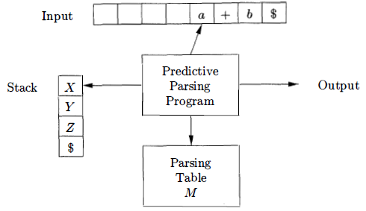
Nonrecursive Predictive Parsing..
The input buffer contains the string to be parsed, followed by the end marker $
The parser is controlled by a program that considers X, the symbol on top of the stack, and a, the current input symbol.

Slide 18
Nonrecursive Predictive Parsing...
The parser is controlled by a program that considers
X the symbol on top of the stack
a the current input symbol
If X is a non-terminal , the parser chooses an X-production by consulting entry M[X,a] of the parsing table M
Otherwise, it checks for a match between the terminal X and current input symbol a
The behavior of the parser can be described in terms of its configurations

Slide 19
Nonrecursive Predictive Parsing...
Table-driven predictive parsing algorithm describes how configurations are manipulated
INPUT: A string w and a parsing table M for grammar G.
OUTPUT: If w is in L(G) a leftmost derivation of W, otherwise, an error indication.
METHOD: Initially, the parser is in a configuration with w$ in the input buffer and the start symbol S of G on top of the stack, above $

Slide 20
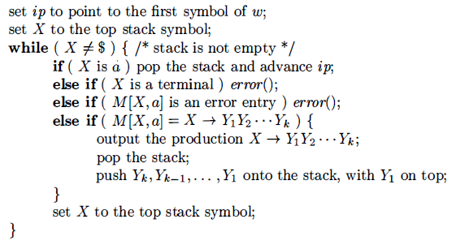
Nonrecursive Predictive Parsing...
Ex. Our same grammar. Input String id + id * id
Already have its Parsing table

Slide 21
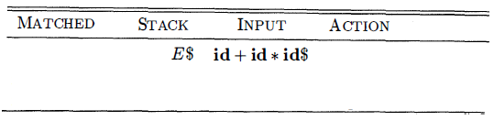
Nonrecursive Predictive Parsing...

Slide 22
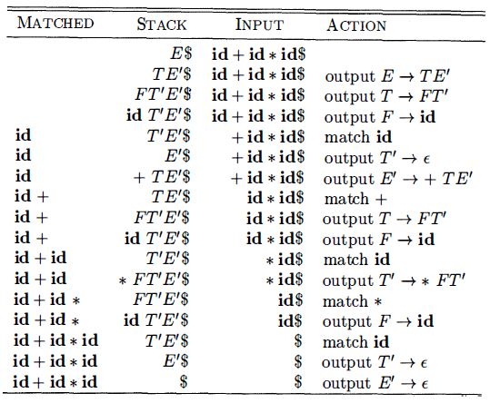
Nonrecursive Predictive Parsing...

Slide 23
Error Recover in Predictive Parsing
An error is detected during predictive parsing when the terminal on top of the stack does not match the next input symbol.
Or we can say that when non-terminal A is on top of the stack, a is the next input symbol, and M[A,a] is error.
Two types of error recoveries we will discuss
Panic Mode Recovery
Phrase Level Recovery

Slide 24
Error Recover in Predictive Parsing..
Panic Mode Recovery
Panic-mode error recovery is based on the idea of skipping symbols on the input until a token in a selected set of synchronizing tokens appears.
Its effectiveness depends on the choice of synchronizing set.
The sets should be chosen so that the parser recovers quickly from errors that are likely to occur in practice.

Slide 25
Error Recover in Predictive Parsing...
Some heuristics are:
As a starting point, place all symbols in FOLLOW(A) into the synchronizing set for non-terminal A. If we skip tokens until an element of FOLLOW(A) is seen and pop A from the stack, it is likely that parsing can continue.
If we add symbols in FIRST(A) to the synchronizing set for non-terminal A then it may be possible to resume parsing according to A if a symbol in FIRST(A) appears in the input.

Slide 26
Error Recover in Predictive Parsing...
If a non-terminal can generate the empty string, then the production deriving ɛ can be used as a default. Doing so may postpone some error detection, but cannot cause an error to be missed. This approach reduces the number of non-terminals that have to be considered during error recovery.
If a terminal on top of the stack cannot be matched, a simple idea is to pop the terminal, issue a message saying that the terminal was inserted, and continue parsing.

Slide 27
Error Recover in Predictive Parsing...
Phrase-level Recovery
Phrase-level error recovery is implemented by filling in the blank entries in the predictive parsing table with pointers to error routines.
These routines may change, insert, or delete symbols on the input and issue appropriate error messages.
They may also pop from the stack. Alteration of stack symbols or the pushing of new symbols onto the stack is questionable for several reasons.
First, the steps carried out by the parser might then not correspond to the derivation of any word in the language at all.
Second, we must ensure that there is no possibility of an infinite loop.

Slide 28
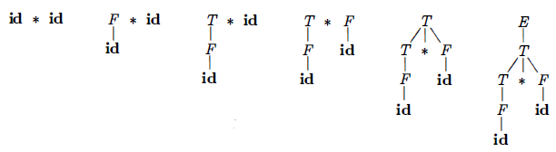
Bottom-up Parsing
A bottom-up parse corresponds to the construction of a parse tree for an input string beginning at the leaves (the bottom) and working up towards the root (the top)
A bottom-up parse for id * id

Slide 29
Reductions
Bottom-up parsing is the process of "reducing" a string w to the start symbol of the grammar.
At each reduction step, a specific substring matching the body of a production is replaced by the non-terminal at the head of that production.
The key decisions during bottom-up parsing are about when to reduce and about what production to apply, as the parse proceeds.

Slide 30
Reductions..
A sequence of reductions are shown.
id * id, F * id, T * id, T * F, T, E
By definition, a reduction is the reverse of a step in a derivation.
The goal of bottom-up parsing is to construct a derivation in reverse.

Slide 31
Handle Pruning
The strings that are reduced during the reverse of a rightmost derivation are called the handles.
Informally, a "handle" is a substring that matches the body of a production, and whose reduction represents one step along the reverse of a rightmost derivation.
Reduction Production | Handle | Right Sentential Form
F → id | Id₁ | Id₁ * id₂
T → F | F | F * id₂
F → id | id₂ | T * id₂
E → T * F | T * F | T * F

Slide 32
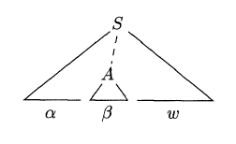
Handle Pruning..
Formally
if S ⇒* αAw then production A → β in the position following α is a handle of αAw
The string w to the right of the handle must contain only terminal symbols

Slide 33

Shift-Reduce Parsing
Shift-reduce parsing is a form of bottom-up parsing in which a stack holds grammar symbols and an input buffer holds the rest of the string to be parsed.
Handle will always appears at the top of the stack just before it is identified as the handle
We use $ to mark the bottom of the stack and also the right end of the input.
Initially, the stack is empty and the string w is on the input

Slide 34
Thank You

